Slide 1
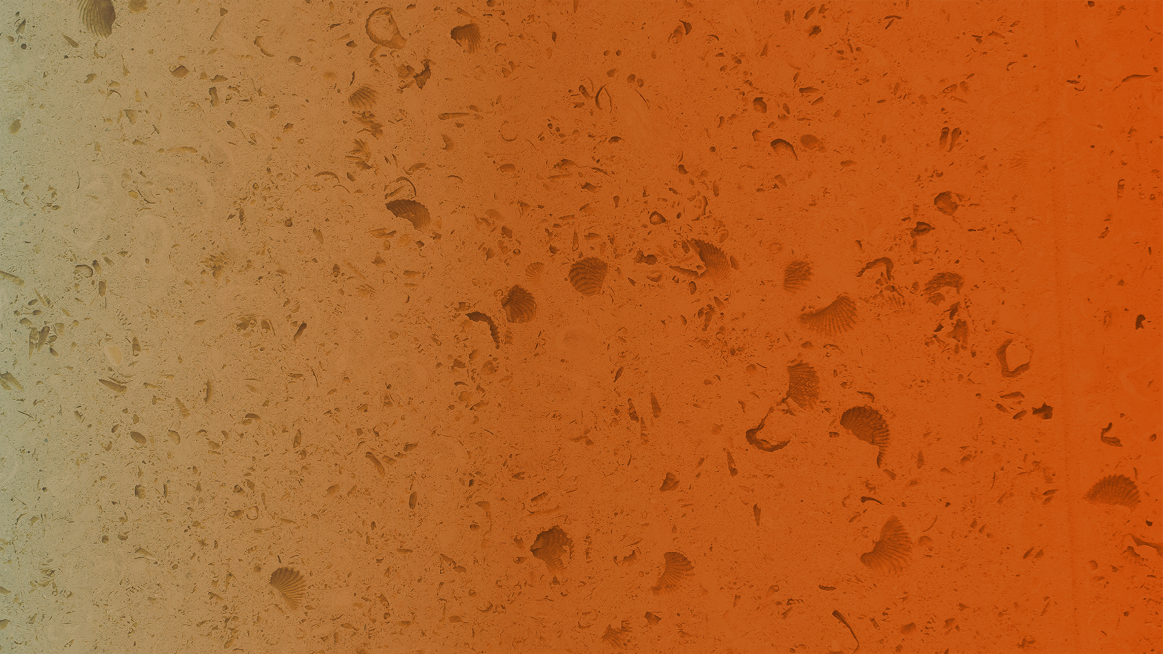

Fall 2018
Applied engineering Data analysis, optimization and visualization
Neural networks and deep learning
Joshua Rhodes, PhD
Research Fellow/Adjunct Professor, The University of Texas at Austin

Slide 2
Neural networks are kind of like regression, but with more blackbox
With regression, we knew the various weights given to each of the explanatory variables
With (artificial) neural networks, we might not have as much insight into what is going on
But if it works, don’t fix it?
Heavy trainers

Slide 3
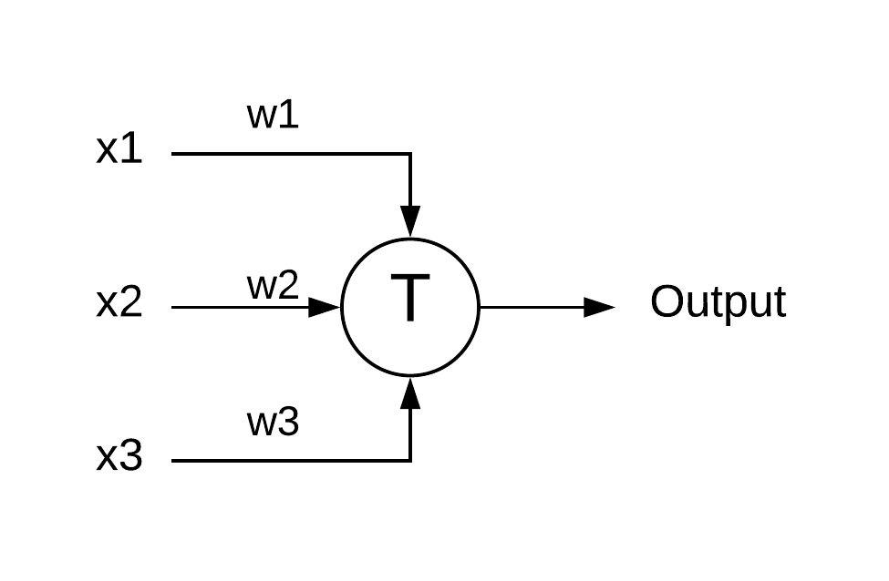
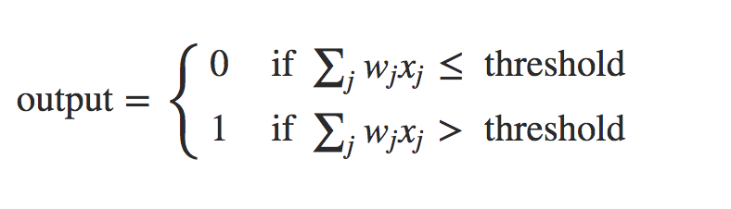
The simplest NNs are similar-ish to logistic regression
Perceptions
Takes several binary inputs and produces a binary output
* http://neuralnetworksanddeeplearning.com/chap1.html

Slide 4
Example: Should I go to ACL?
x1: Is the weather good? (no/yes, or 0/1)
x2: Do friends want to go?
x3: Can I take a bus?
w1: I hate bad weather, so = 6
w2: Friends are nice, but = 2
w3: Parking is bad, but not a deal-breaker = 2
Set T to 5, so c(0,1,1) = 4 < 5, so no-go 0
Set T to 3, so c(0,1,1) = 4 > 3, so yes-go! 1

Slide 5
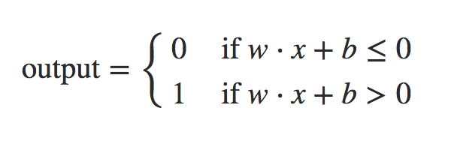
The threshold of a Perceptions must be overcome to get a positive result, or 1
If we say that bias b = -threshold, then:

Slide 6
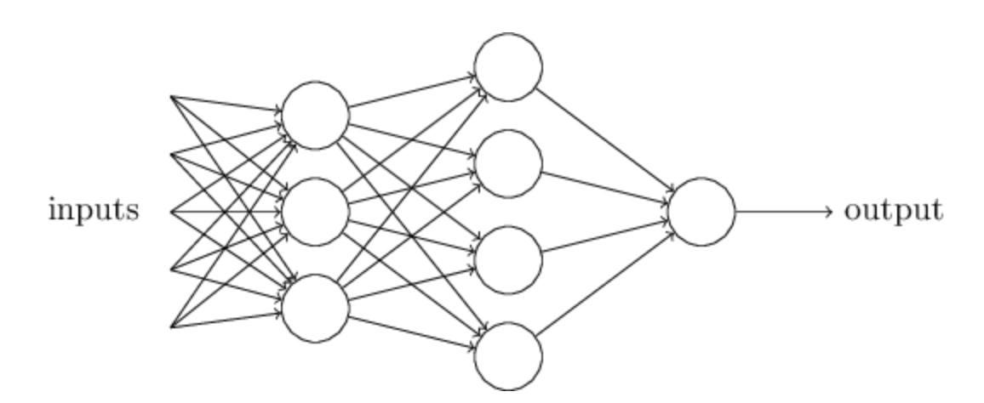
Each perception has a single output, but it can be an input to multiple other perceptions

Slide 7
How do we get these things to “learn”?
After all, that is what we are after, right?
One way:
Make a small change to a weight, w_{i}, and we should see a small change in the output, right?
We learn by correcting our mistakes towards getting the answer “more right” – practice
The problem is that since perceptions only output a 0 or 1, a small change in w_{i} can lead to a big change in output

Slide 8
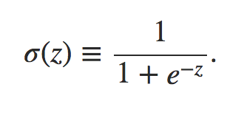
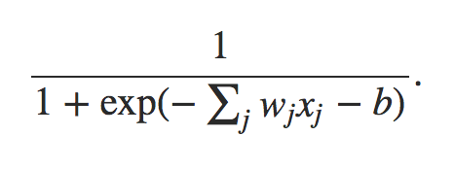
Enter the sigmoid neuron, a quantum leap
Takes on the whole range from 0 to 1.
Uses the sigmoid function:
In our nomenclature:

Slide 9
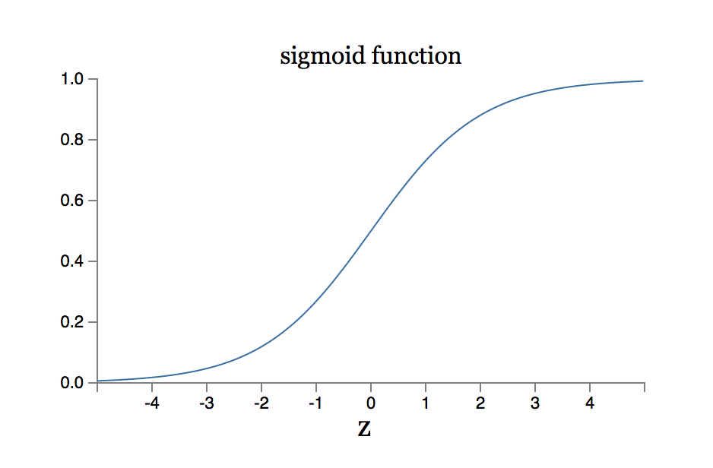
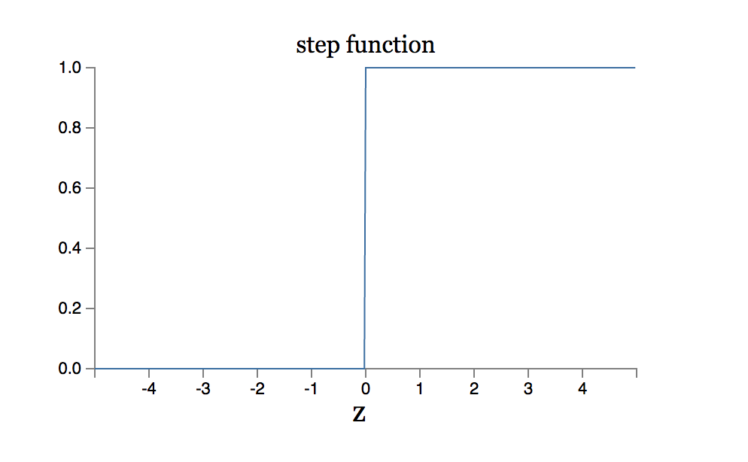
Different functions = different results

Slide 10
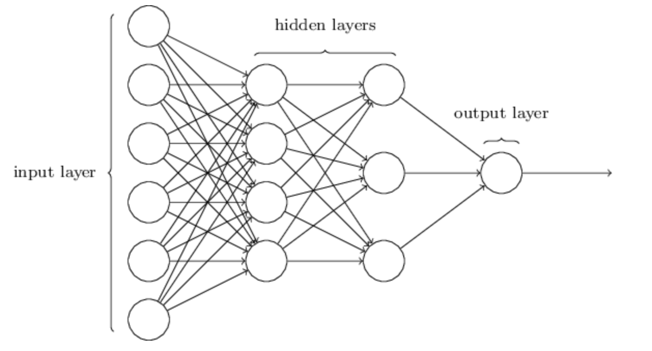
The architecture of neural networks

Slide 11

MNIST: Modified National Institute of Standards and Technology
Classic deep learning dataset
Handwritten digits that a computer is taught to learn via deep learning
Images are 28x28 pixels, flattened into a vector 784 in length

Slide 12
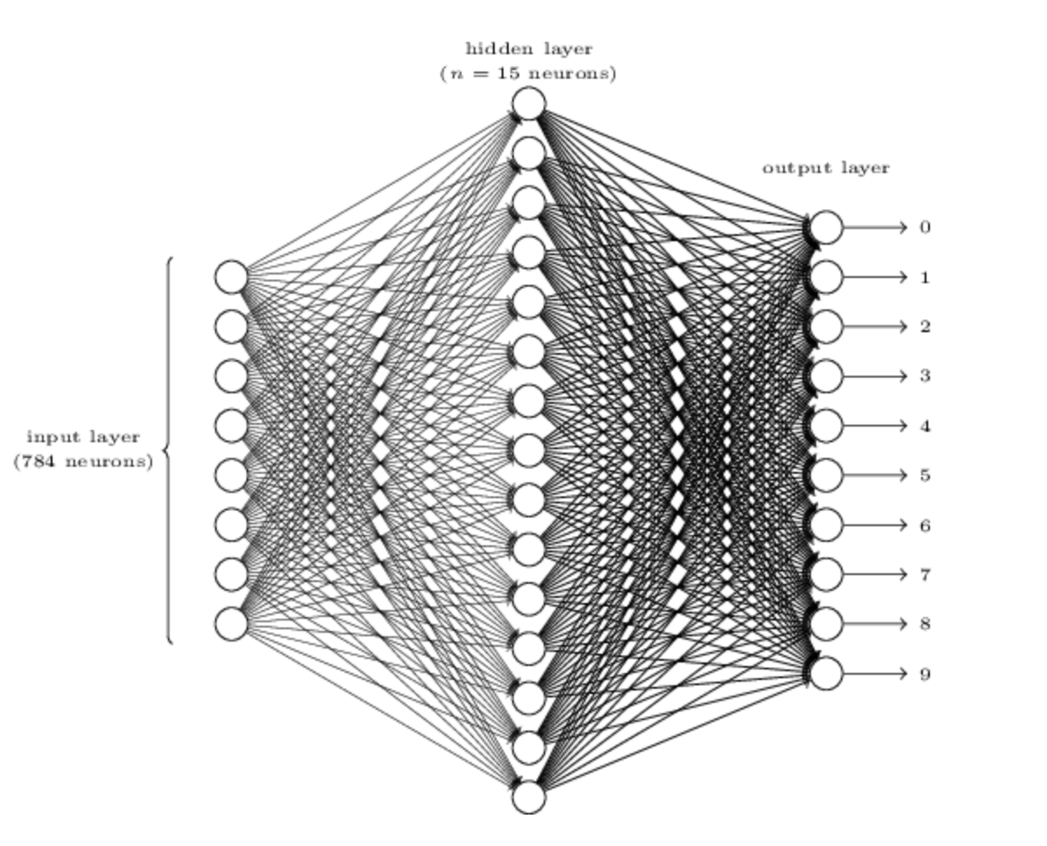
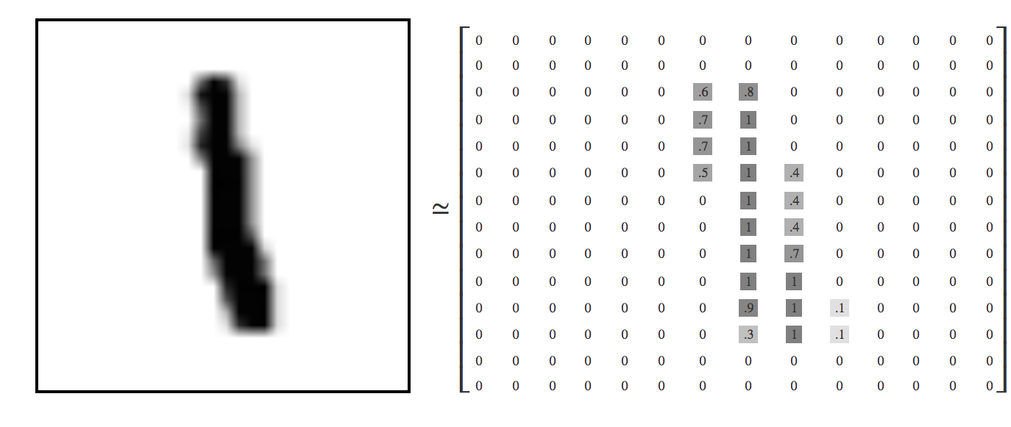
Image recognition with NN
Essentially various output layers weight different parts of the image differently

Slide 13
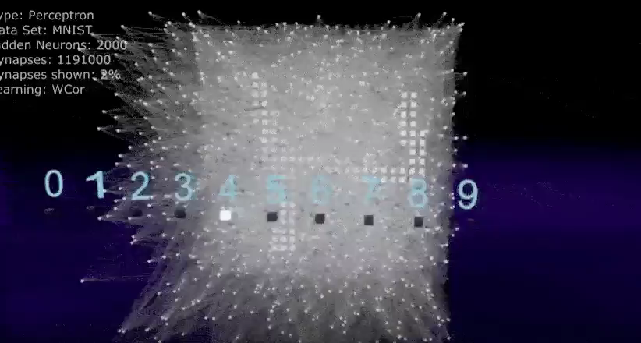
Super cool gif showing NN image recognition

Slide 14
Keras and tensorflow
Tensorflow is a library used to make deep learning models
Keras is a packge that makes Tensorflow more user-friendly
Both are popular in deep learning

Slide 15
More resources
http://colah.github.io/posts/2014-10-Visualizing-MNIST/
https://tensorflow.rstudio.com/tensorflow/articles/tutorial_mnist_beginners.html

Slide 16
Let’s dig in to a VERY simple example with power plants!

